Slide 1

SpelliNg Test
Yu-Ching Ho
Nathanael Omnes

Slide 2


Introduction
Spelling Test has moved over to Unity and been scaled down.
Removed over-world map and less Elemental Masters to fight.
Notes:
nath

Slide 3
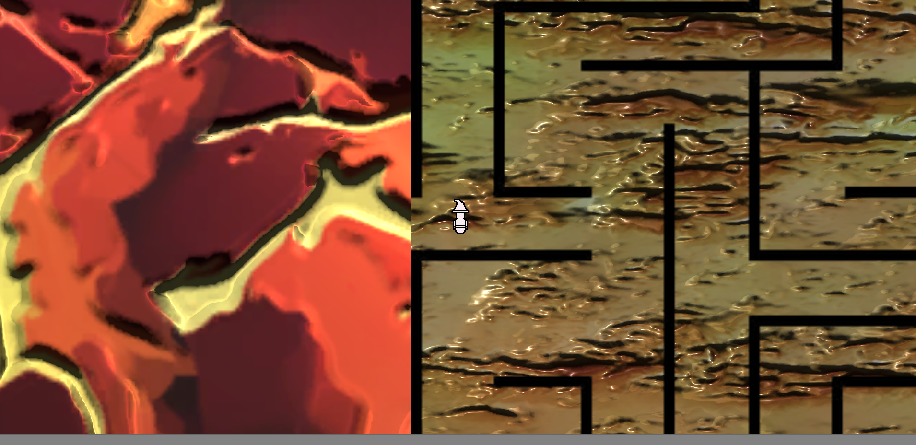

Fire Master
Notes:
david

Slide 4



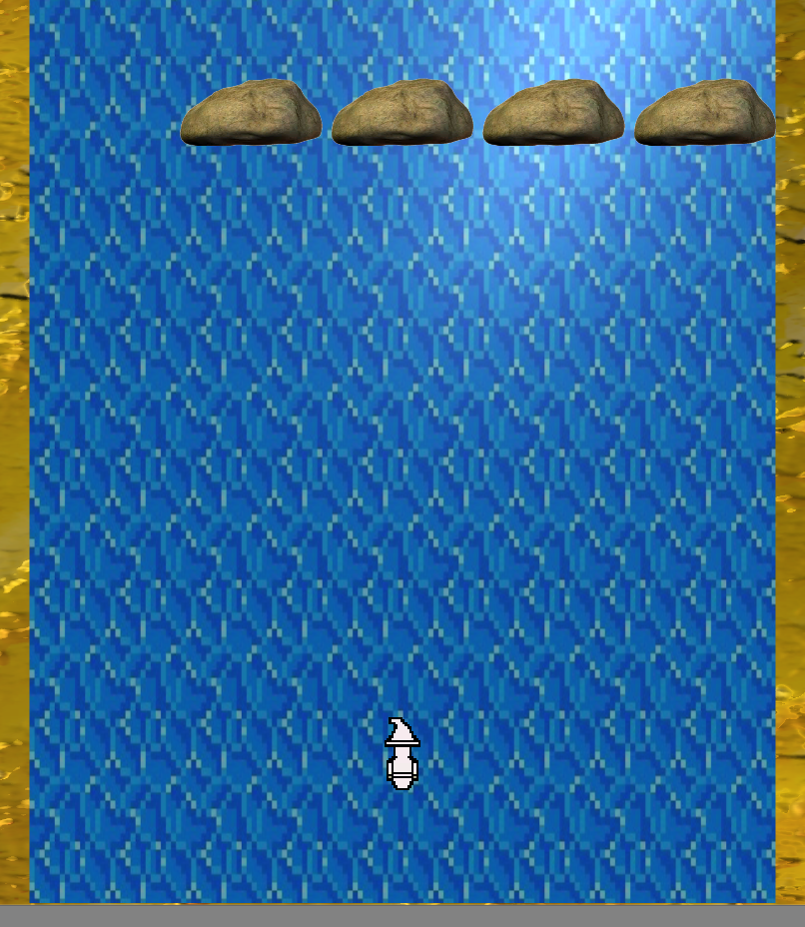

Water Master
Notes:
Yoshi

Slide 5




Grand Master
Notes:
yoshi

Slide 6
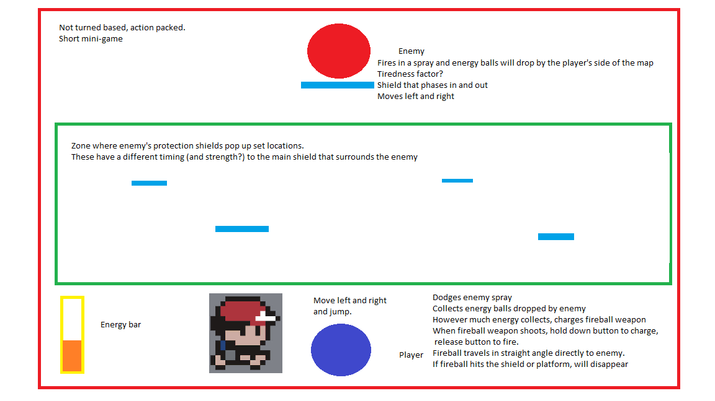
Gameplay
An early prototype idea for one of the many boss battles we will have in the game:
Each one will be different!
Notes:
yoshi

Slide 7
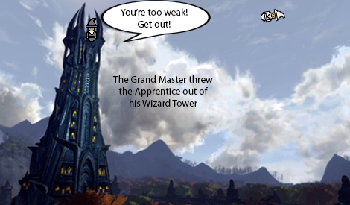
Story
Used cut-scenes
Linear progression
Gets chucked out of the Wizard Tower
Travels and beats the other Masters
Powers up to face his old Master
Notes:
david

Slide 8
Audio
Nath
Notes:
david

Slide 9
Risk Analysis (Project) Updated
Risks | Probability (⅕) | Severity(⅕) | Risk level
A late change of game engine | 5 | 1 | 5
Lateness/non-participation | 4 | 3 | 12
Bad team communication | 1 | 3 | 6
Missing work | 3 | 3 | 9
Notes:
Nath, unity

Slide 10
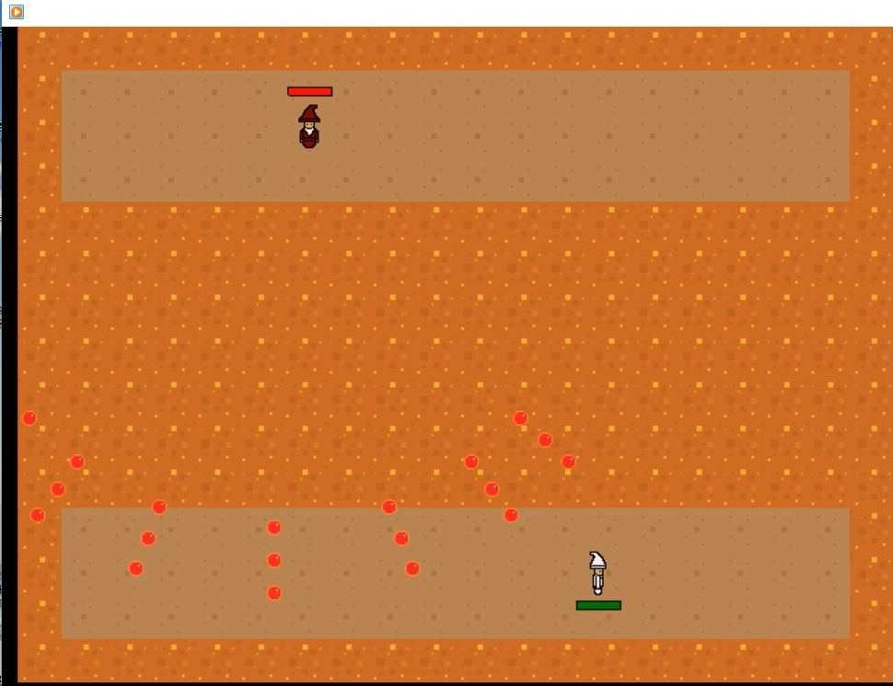
Final Demo
Notes:
yoshi

Slide 11

Questions?

